Slide 1
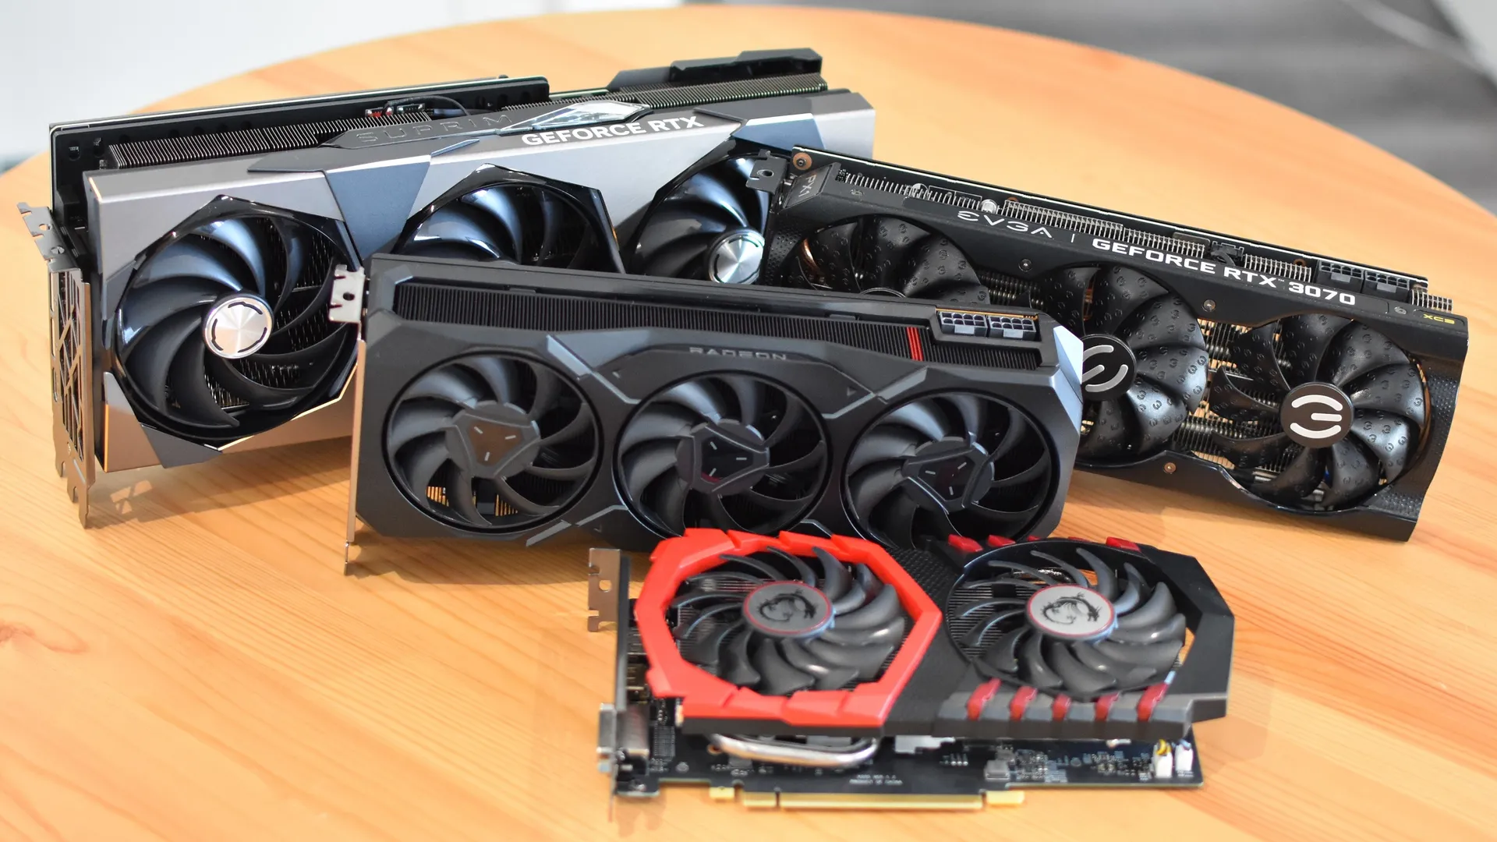
INFO 450 Final Project: NVIDIA, AMD, Intel, ASUS, MSI share prices (GPU)
Natalie Ramdeo
4/17/2023

Slide 2

Problem Statement
PC gaming has been something that’s been on the rise for the past few years, and with this comes the rise of the number of graphics cards sold. Moreso since the COVID pandemic with revenue going up to the billions. Despite graphics cards being sold at a very high rate, there’s a problem that’s started to occur because of it.
Getting a good graphics card can already be expensive, but some of the prices of these graphics cards can go all the way up to 1000s. And for some people, it may be hard to get a high-end graphics card when you’re already spending a lot on building your PC. Not to mention that if you get a graphics card that’s good for your budget, the chances of that giving you to performance that you want. To add to that, a lot of games that are coming out will require more high-end graphics cards to be used to give the best performance, which will make it harder for many people to to run their games.

Slide 3
Methodology
The way I broke down this problem is by taking each dataset and analyzing each section of it, starting from the beginning of the companies all the way to the current year.
While I do look at the stats from the beginning of companies to now, I will also be looking more at the stats from the recent years since that’s where we start to see a rise for each of the companies.

Slide 4

Findings
According to my findings, it’s clear that Nvidia is number one when it comes to GPU sales. That’s also expected since when it comes to PC builds, a large majority of people would choose to go with an Nvidia graphics card over any other brand. And that was from the start of their company to now.
Following Nvidia, was Intel, which was surprising to me considering that Intel’s graphics cards aren’t the best for high-end gaming.

Slide 5

Findings Cont.
After Intel came Asus, which surprised me because I believed that more people would have chosen MSI GPUs over Asus GPUs, but that’s not the case. In fact, Asus GPUs completely outsells Msi GPUs.
After Asus is Msi. As stated before, this was a surprise to me because I thought Msi GPUs would be more popular than Asus GPUs, but instead, it’s the opposite,
After Msi comes AMD, which is the final one out of all the companies mentioned. This was shocking to me because when you look at AMD from the beginning to know, you can tell that things started out drastically different. In the beginning, AMD weren’t that big, but they started gaining popularity in the recent years.

Slide 6
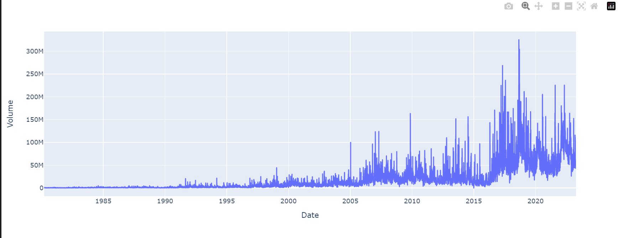
AMD

Slide 7
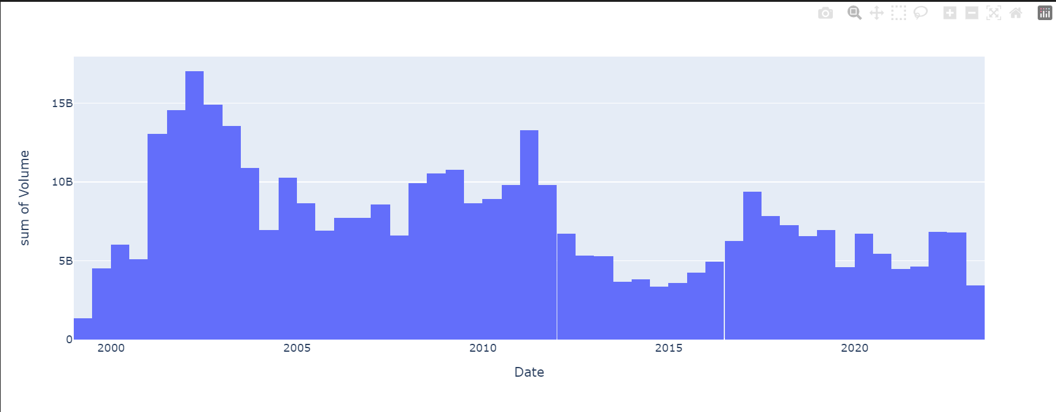
Nvidia

Slide 8
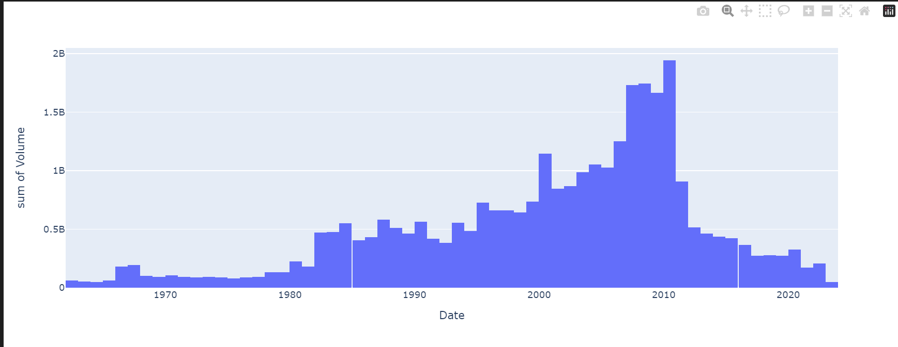
MSI

Slide 9
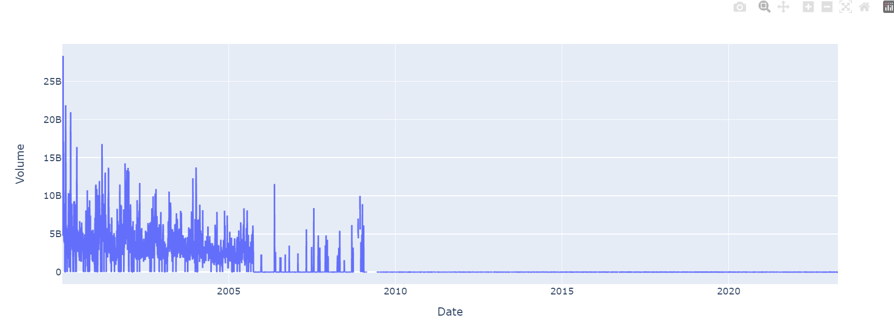
Asus

Slide 10
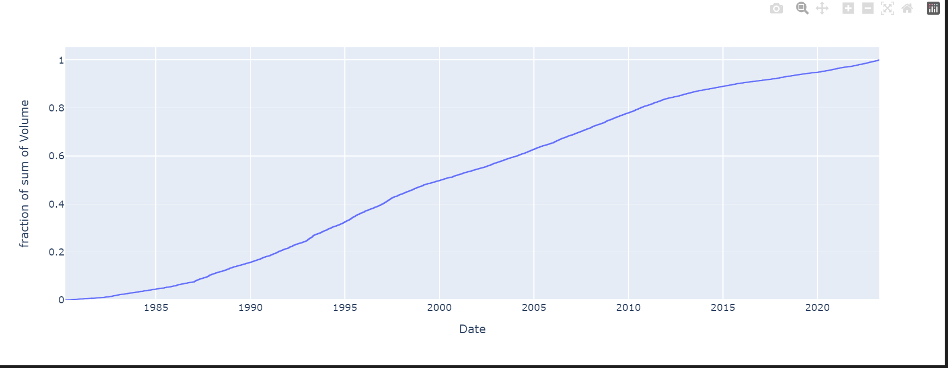
Intel

Slide 11
Findings Cont.
When you compare the stats from the recent years, there’s a major difference than when you look at it from the start of each company.
While it’s clear that Nvidia is still number one in terms of GPU sales, following after was AMD. This was fascinating because for a while, AMD lacked a lot in the GPU department, but in these past few years, they’ve stepped up and came out with GPUs that are affordable and gives you the performance people are looking for.
After looking at AMD in the recent years, you see MSI take off, and then after MSI came Asus.
Note: I excluded talking about Intel for this small section of my findings because Intel’s GPU isn’t the best for people looking to game with high frame rates and high resolutions.

Slide 12
Recommendations
One thing that I would recommend is that Intel should jump onto the dedicated graphics race. In terms of graphics, they do a dedicated GPU known as “intel iris xe graphics”, but when you look at the benchmarks for it, it isn’t the best for high-end gaming. If Intel were to create a dedicated GPU that’s on par with graphics cards like Nvidia, people would have more options to choose from rather than sticking with 1 or 2 brands.
Another thing that I would recommend is that Nvidia, AMD, ASUS, and MSI focus on making some of their lower GPU cards able to play games that may seem impossible to play without having their high-end graphics cards.
While their lower-end cards already does a reasonable job, there’s still a chance the same lower-end gpus start to decrease in performance.
To avoid that, they can choose to make improvements on the lower-end cards to make it so that they can play games just as well as the high-end cards they are selling.

Slide 13

Future Work
By making these adjustments, Nvidia, AMD, MSI, ASUS, and Intel can create something that can impact consumers in a positive way. They’ve already done a fantastic job with making GPUs that are not only high-end, but budget friendly for all to have an amazing gaming experience. However, if they make the adjustments that’s mentioned in the previous slide, then consumers will have a much better time getting an affordable GPU, which would also help them game at a high resolution and high frame rate.

